Slide 1

THERMODYNAMICS I (ME 265)
PROPERTIES OF PURE SUBSTANCES AND INTRODUCTION TO VAPOUR POWER CYCLES
Francis Kofi Forson (Professor)
Department of Mechanical Engineering
Kwame Nkrumah University of Science and Technology, Kumasi, Ghana

Slide 2
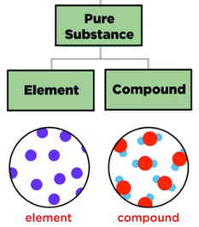
Pure Substance
A substance that has a fixed chemical composition throughout is called a pure substance such as water, air, and nitrogen.
A pure substance may exist in different phases. The three principal phases are solid, liquid, and gas.
A phase is defined as having a distinct molecular arrangement that is homogenous throughout and separated from others (if any) by easily identifiable boundary surfaces.
A pure substance does not have to be of a single element or compound. A mixture of two or more phases of a pure substance is still a pure substance as long as the chemical composition of all phases is the same.

Slide 3
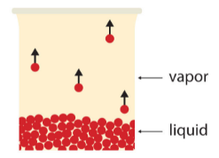
Properties of Liquids and Vapours
Matter may exist in the form of a solid, liquid or a gas.
A vapour is a gas existing at a temperature at which it can be liquefied by an increase of pressure.
State Postulate: Two independent properties are needed to completely specify the state of a thermodynamic system.
If these two independent properties are known, the other properties can be determined.

Slide 4
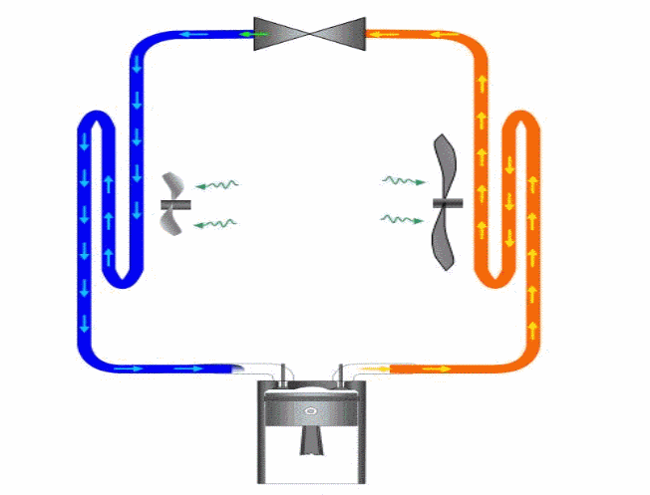
Properties of Liquids and Vapours
Refrigeration cycle (Vapour-compression)
4

Slide 5
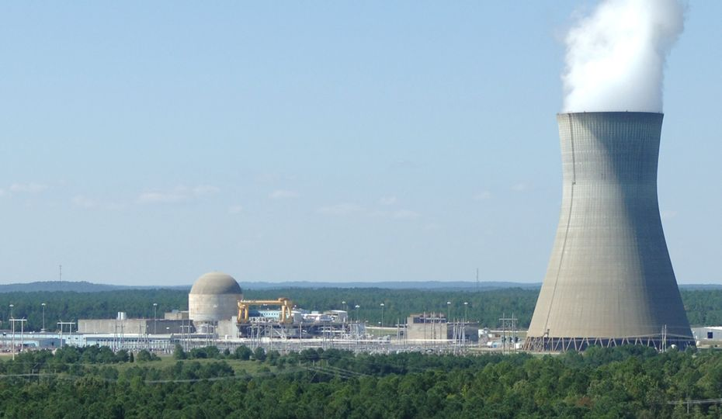
Properties of Liquids and Vapours
Steam power cycle
5

Slide 6
Properties of Liquids and Vapours
Phase Change Experiment
Consider a unit mass (1 kg) of water at a temperature of 20 °C, atmospheric pressure of 1.013 bar, contained in a cylinder as shown.
State 1
State 2
State 3
State 4
State 5
P = 1 bar
T = 300 ºC
P = 1 bar
T = 100 ºC
P = 1 bar
T = 20 ºC
P = 1 bar
T = 100 ºC
P = 1 bar
T = 100 oC
Under-saturated liquid
Sub-cooled Liquid
Compressed liquid
Saturated liquid
Saturated liquid-vapour mixture
Saturated vapour
Superheated vapour

Slide 7


Properties of Liquids and Vapours
Temperature-Specific Volume Diagram for Water
5
300
Sensible heat
Latent heat
100
4
2
3
Sensible heat
20
1

Slide 8


Properties of Liquids and Vapours
Temperature-Volume Diagram for Water
The properties of saturated liquid, saturated vapour and superheated vapour for water are listed in tables.
The subscript ‘f’ is used to denote properties of a saturated liquid, and the subscript ‘g’ to denote the properties of saturated vapour.
P₂ = const.> P₁
Critical Point
Compressed Liquid Region
P₁ = const.
Superheated Vapour Region
Saturated liquid-vapour region or wet region
Saturated liquid line
Saturated vapour line

Slide 9
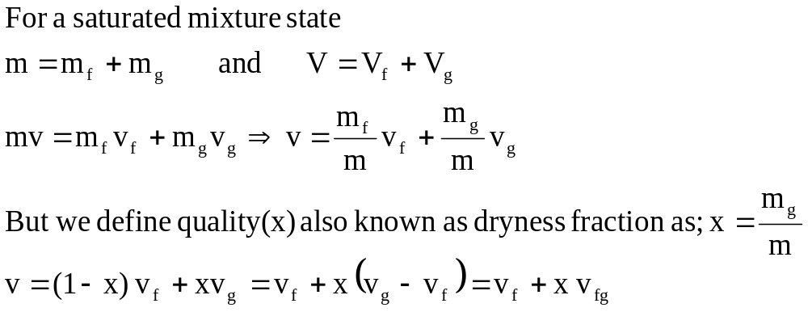
Properties of Liquids and Vapours
Properties of a Saturated liquid-vapour mixture (wet mixture)

Slide 10
Properties of Liquids and Vapours
Table of Properties for Water

Slide 11
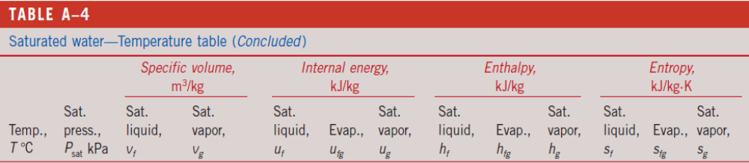
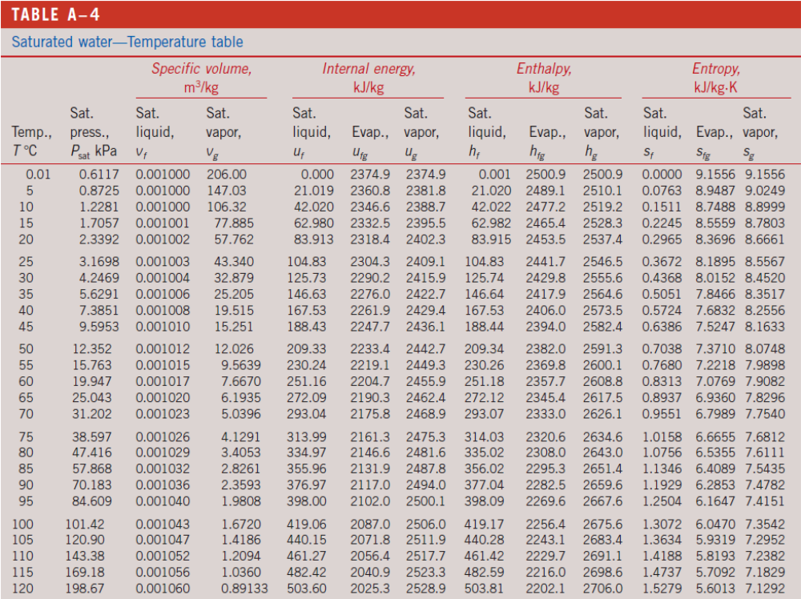
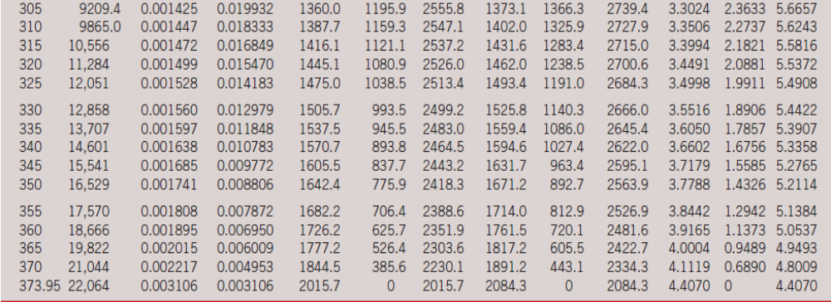
11

Slide 12
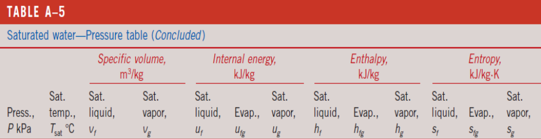
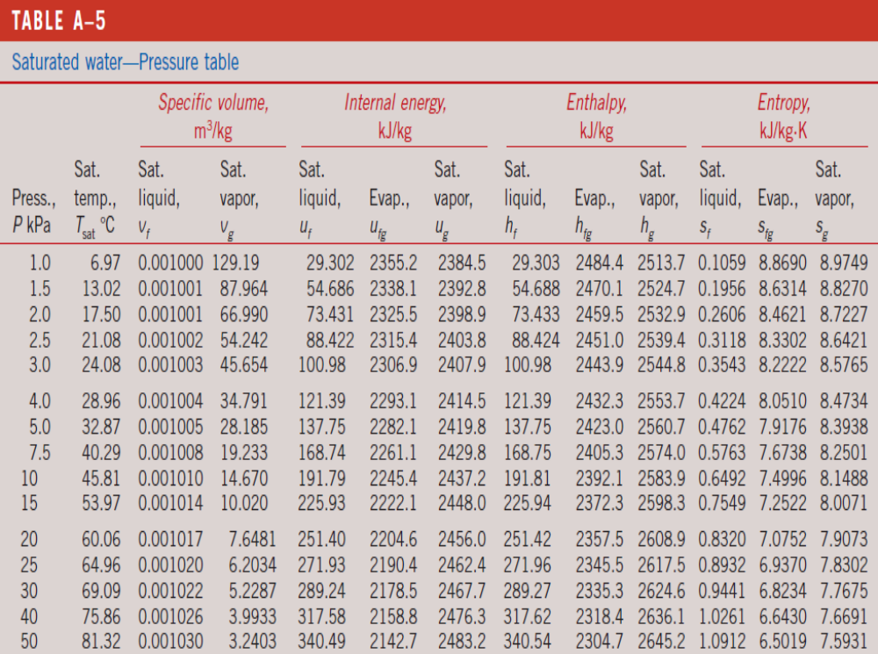
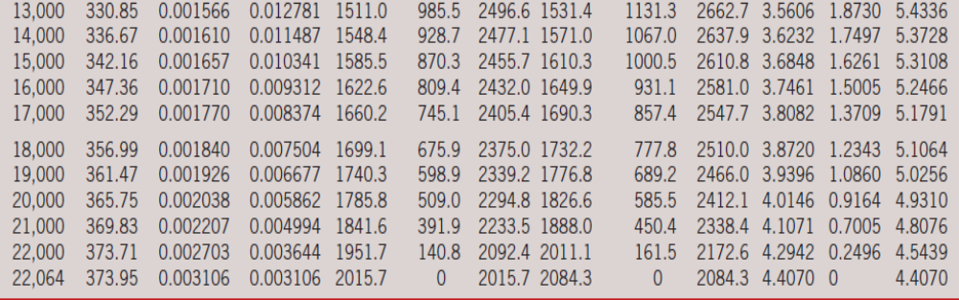
12

Slide 13
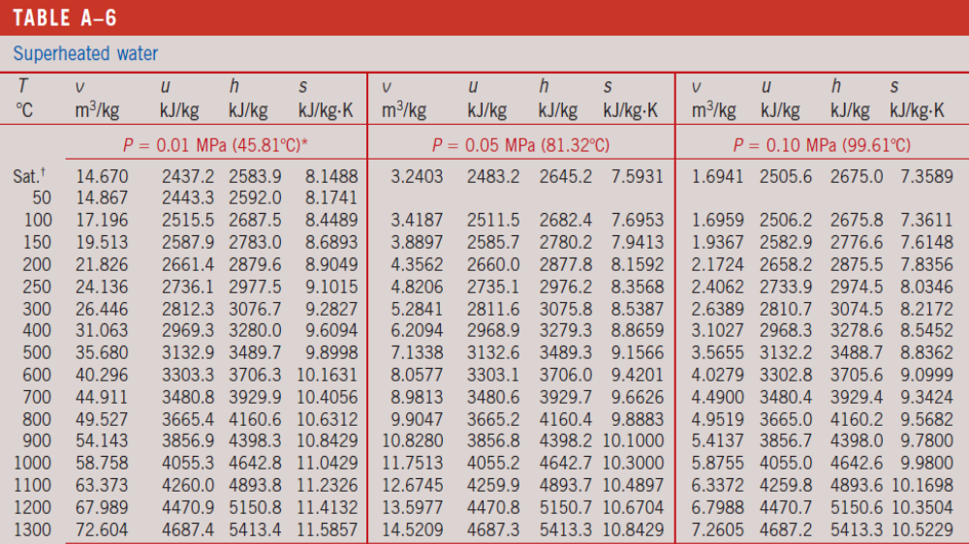

Slide 14
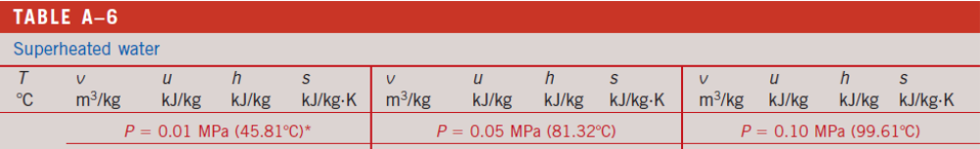
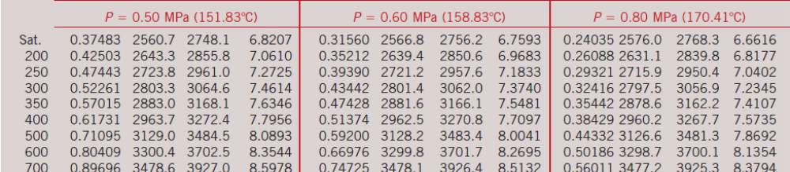
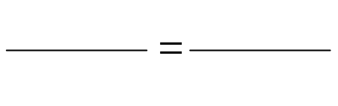
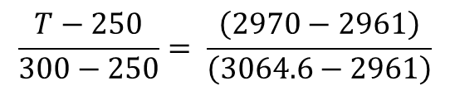
Use of Interpolation in Tables of Properties
Determine the temp. of water at a state of P = 0.5 MPa and h = 2970 kJ/kg
T (ºC) | h (kJ/kg)
250 | 2961.0
? | 2970.0
300 | 3064.6
$$\frac{T−250}{300−250}= \frac{\left(2970−2961\right)}{\left(3064.6−2961\right)}$$
254.33

Slide 15
Properties of Liquids and Vapours: Problems
Problem 1
Steam at 3 bar has a dryness fraction of 0.8. Calculate its specific volume, specific enthalpy, and specific internal energy
Suggested Answers:
[0.4848 m³/kg; 2292.2 kJ/kg; 2146.8 kJ/kg]
Problem 2
A cylinder contains 0.34 kg of steam at 10 bar. If the volume of the cylinder is 0.05 m³, calculate the dryness fraction of the steam, the internal energy, and the enthalpy.
Suggested Answers:
[0.755; 726.4 kJ, 776.4 kJ]

Slide 16
Properties of Liquids and Vapours: Problems
Problem 3
A mass of 200 g of saturated liquid water is completely vaporized at a constant pressure of 100 kPa. Determine the amount of heat energy added to the water.
Suggested Answer: [451.5 kJ]
Problem 4
10 kg of a mixture of saturated vapour and saturated liquid in a 5 m³ tank is at a pressure of 150 kPa. Find its temperature and the fraction of vapour in the mixture.
Suggested Answers:
[111.35 °C; 0.43]

Slide 17
Properties of Liquids and Vapours: Problems
Problem 5
0.05 kg of Steam at 100 kPa, dryness fraction of 0.85 is heated at constant pressure to a temperature of 200 °C. Determine the changes in volume, internal energy, enthalpy and entropy of the steam.
Suggested Answer: [0.03662 m³; 23.3 kJ; 26.96 kJ; 0.0693 kJ/K]
Problem 6
1 kg of steam 0.8 dry at 9 bar expands during a non-flow polytropic process according to the law PV^{1.1} = constant until the pressure becomes 3 bar. Calculate the final dryness fraction, the work energy transfer, and the heat energy transfer.
Suggested Answer: [0.772; 144.9 kJ; 56.7 kJ]

Slide 18
Properties of Liquids and Vapours: Problems
Problem 7
Steam enters a steam turbine at 5 MPa, and 500 °C at a rate of 50 kg/s and leaves it at a pressure of 10 kPa. The quality of steam at the turbine exit is 0.95. What is the magnitude of the power output from this turbine?
Suggested Answer: [48.5 MW]
Problem 8
Steam is accelerated by a nozzle steadily from a low velocity to 210 m/s at a rate of 3.2 kg/s. If the temperature and pressure of the steam at the nozzle exit are 400 °C and 2 MPa, what is the exit area of the nozzle in cm²?
Suggested Answer: [23.04 cm²]

Slide 19
Properties of Liquids and Vapours: Problems
Problem 9
Steam at 1MPa and 300 °C is throttled adiabatically to a pressure of 0.4 MPa. If the change in kinetic energy is negligible, what is the specific volume of the steam after throttling?
Suggested Answer: [0.646 m³/kg;]
Problem 10
Steam expands in a turbine from 4 MPa and 500 °C to 0.5 MPa and 250 °C at a rate of 1350 kg/h. Heat is lost from the turbine at a rate of 25 kJ/s during the process. What is the power output of the turbine?
Suggested Answer: [156.9 kW]

Slide 20
Properties of Liquids and Vapours: Problems
Problem 11
The power output of an adiabatic steam turbine is 6 MW, and the inlet and the exit conditions of the steam are given as
Inlet Outlet
P₁ = 3.5 MPa P₂ = 20 kPa
T₁ = 600ºC x₂ = 92%
C₁ = 50 m/s C₂ = 150 m/s
Z₁ = 10 m Z₂ = 5 m
Calculate the mass flow rate of the steam in kg/s
Suggested Answer: [4.81 kg/s]

Slide 21
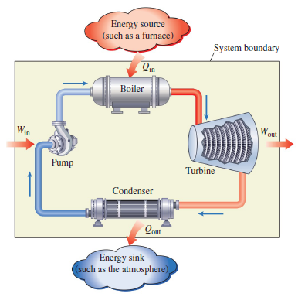
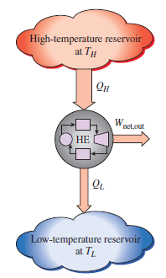
Vapour Power Cycles
Heat Engine Cycle
Steam power plant

Slide 22
Vapour Power Cycles
Characteristics of a vapour power cycle
The working fluid is a condensable vapour, which can be in the liquid phase during part of the cycle.
The cycle consists of steady flow processes with each process carried out in a separate component specially designed for the purpose.
Each component constitutes an open system and all the components are connected in series so that each fluid element passes through thermodynamic states.
In each component, matter flows into and out of region of space. All the processes are considered to be flow processes.
Steam power plant

Slide 23
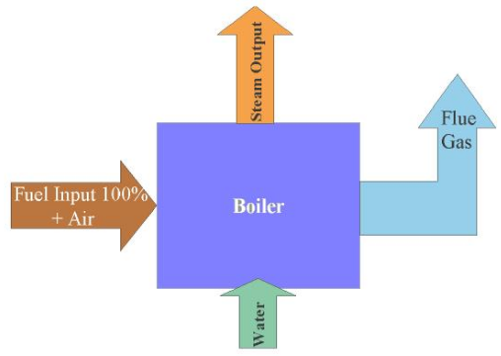
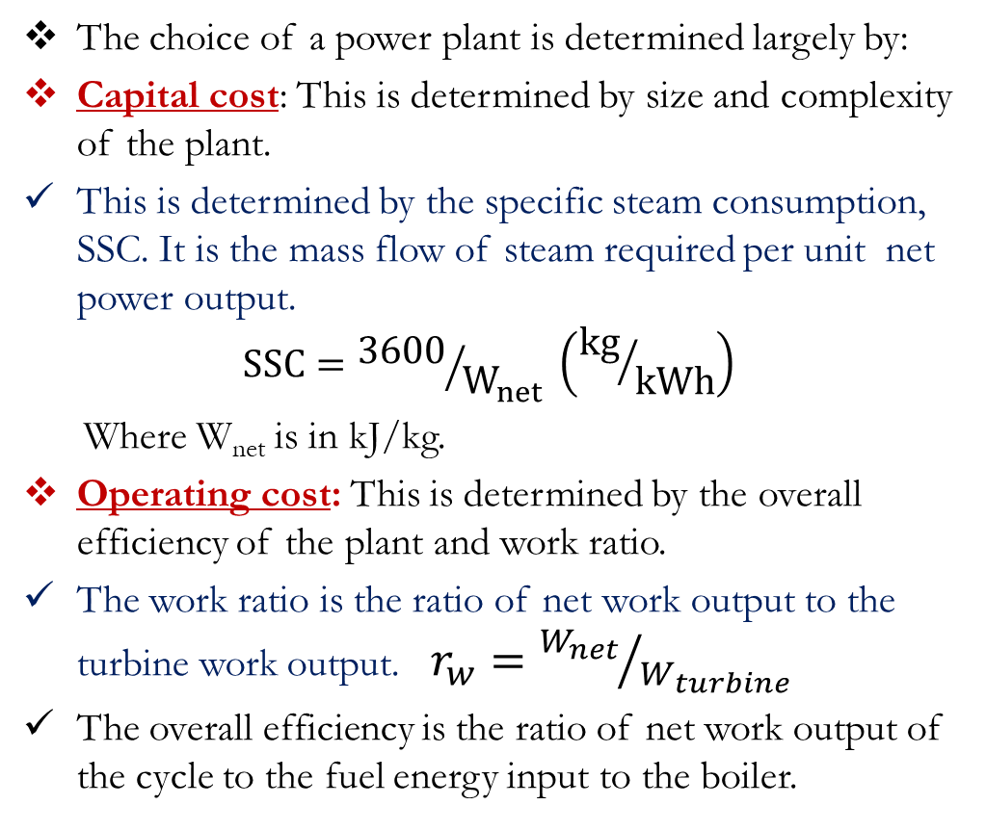
Criteria for Comparing Power Cycles
The choice of a power plant is determined largely by:
Capital cost: This is determined by size and complexity of the plant.
This is determined by the specific steam consumption, SSC. It is the mass flow of steam required per unit net power output.
$$SSC={3600}/{W_{net}} \left({kg}/{kWh}\right)$$
Where W_{net} is in kJ/kg.
Operating cost: This is determined by the overall efficiency of the plant and work ratio.
The work ratio is the ratio of net work output to the turbine work output. $r_{w}={W_{net}}/{W_{turbine}}$
The overall efficiency is the ratio of net work output of the cycle to the fuel energy input to the boiler.
Turbine
Condenser
Pump

Slide 24
Carnot Vapour Power Cycle
The Carnot Cycle consists of four (4) processes
Two isothermal (constant temperature) heat transfer processes
Two reversible adiabatic (constant entropy) work transfer processes
400 MW
Q_{H}
T
1
2
Boiler
165 MW
5 MW
Turbine
1
2
Turbine
Wout
T_{H}
Pump
Win
Condenser
3
T_{C}
4
3
4
Q_{C}
240 MW
S

Slide 25
Carnot Vapour Power Cycle
Reasons why the Carnot cycle is not a practical cycle
The turbine has to handle vapour with low quality: risk of erosion and wear in turbine blades.
It is impractical to design a pump that handles two phase fluid.
It is difficult to control the condensation process that precisely has to end up with the desired quality at point 4.
T
1
2
T_{H}
T_{C}
4
3
S

Slide 26
Carnot And Ideal Rankine Cycles
Carnot cycle :
Two isothermal processes
Two isentropic processes
Ideal Simple Rankine cycle :
Two isobaric processes
Two isentropic processes
T
T
1
2
T_{H}
1
2
T_{H}
T_{C}
4
3
T_{C}
4
3

Slide 27
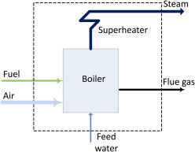
Ideal Rankine Vapour Power Cycle
In general, the efficiency can be improved by increasing the complexity of the plant.
A compromise between low operating and capital costs is therefore required.
One way to improve the efficiency of the Rankine cycle by superheating the saturated steam before it enters the turbine.
This can be done by installing a superheater in the steam flow line at exit from the boiler.

Slide 28



Ideal Rankine Vapour Power Cycle
400 MW
Q_{H}
T
1
2
2
Boiler
Q_{in}
165 MW
5 MW
Turbine
Turbine
Wout
Win
Pump
T_{H}
1
W_{out}
Condenser
3
W_{in}
4
Q_{C}
T_{C}
4
3
240 MW
Q_{out}
S

Slide 29
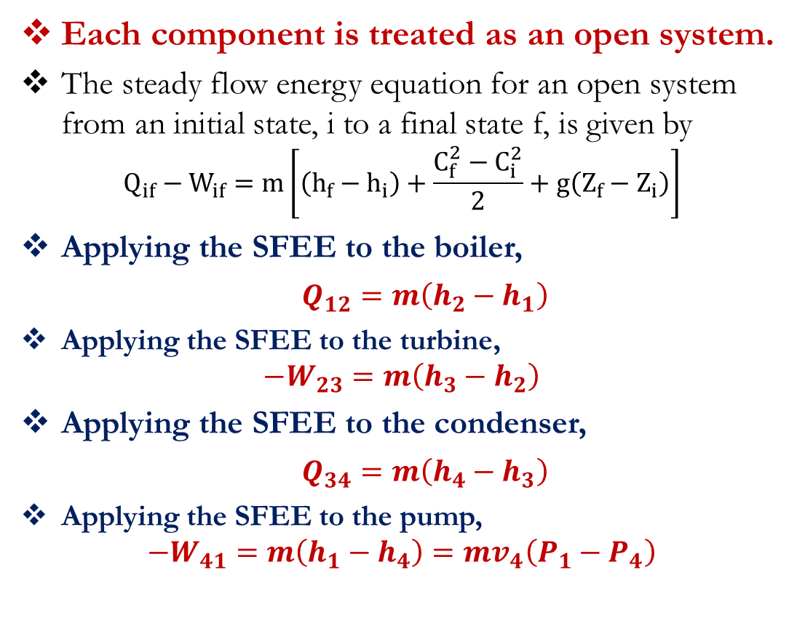
Ideal Rankine Vapour Power Cycle
Each component is treated as an open system.
The steady flow energy equation for an open system from an initial state, i to a final state f, is given by
$$Q_{if}−W_{if}=m\left[\left(h_{f}−h_{i}\right)+\frac{C_{f}^{2}−C_{i}^{2}}{2}+g\left(Z_{f}−Z_{i}\right)\right]$$
Applying the SFEE to the boiler,
$Q_{12}=m\left(h_{2}−h_{1}\right)$
Applying the SFEE to the turbine,
$$−W_{23}=m\left(h_{3}−h_{2}\right)$$
Applying the SFEE to the condenser,
$Q_{34}=m\left(h_{4}−h_{3}\right)$
Applying the SFEE to the pump,
$$−W_{41}=m\left(h_{1}−h_{4}\right)=mv_{4}\left(P_{1}−P_{4}\right)$$
T
2
T_{H}
1
Q_{net}
Q_{H}
4
3
T_{C}
Q_{C}
S

Slide 30
Carnot Power Cycle Problems
Problem 1
A steady-flow Carnot cycle uses water as the working fluid. Water changes from saturated liquid to saturated vapor as heat is transferred to it from a source at 250 °C. Heat rejection takes place at a pressure of 20 kPa. Show the cycle on a T-s diagram relative to the saturation lines, and determine (a) the thermal efficiency, (b) the amount of heat rejected, and (c) the net work output.
Suggested Answers: 36.3%; 1715.3 kJ/kg; 623 kJ/kg
Q_{in}
1
2
Boiler
Turbine
Pump
Turbine
Wout
Win
Condenser
3
4
Qout
T
T_{H}
1
2
T_{C}
4
3
S

Slide 31
Carnot Power Cycle Problems
Problem 2
Consider a steady-flow Carnot cycle with water as the working fluid. The maximum and minimum temperatures in the cycle are 350 and 60 ⁰C. The quality of water is 0.619at the beginning of the heat-rejection process and 0.416 at the end. Show the cycle on a T-s diagram relative to the saturation lines, and determine (a) the thermal efficiency, (b) the pressure at the turbine inlet, and (c) the net work output.
Suggested Answers: (a) 0.465, (b) 16.53 MPa, (c) 441.6 kJ/kg
Q_{in}
1
2
Boiler
Turbine
Pump
Turbine
Wout
Win
Condenser
3
4
Qout
T
T_{H}
1
2
T_{C}
4
3
S

Slide 32
Ideal Rankine Power Cycle Problems
Problem 1
Consider a 210-MW steam power plant that operates on a simple ideal Rankine cycle. Superheated steam enters the turbine at 10 MPa and 500 °C and is cooled in the condenser at a pressure of 10 kPa. Show the cycle on a T-s diagram with respect to saturation lines, and determine (a) the quality of the steam at the turbine exit, (b) the thermal efficiency of the cycle, and (c) the mass flow rate of the steam.
Suggested Answers: (a) 0.793, (b) 40.2 percent, (c) 165 kg/s
Q_{in}
1
2
Boiler
Turbine
Pump
Turbine
Wout
Win
Condenser
3
4
Qout
T
2
T_{H}
1
T_{C}
4
3
S

Slide 33
Ideal Rankine Power Cycle Problems
Problem 2
A simple ideal Rankine cycle operates between
the pressure limits of 10 kPa and 3 MPa, with a turbine inlet temperature of 600 °C. Disregarding the pump work, determine the cycle efficiency.
Suggested Answers: 37.3%
Q_{in}
1
2
Boiler
Turbine
Pump
Turbine
Wout
Win
Condenser
3
4
Qout
T
2
T_{H}
1
T_{C}
4
3
S

Slide 34
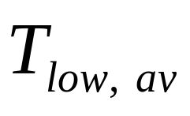
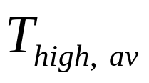
Options for improving the efficiency of the Basic Rankine Cycle
)
The basic idea behind all the modifications to increase the thermal efficiency of a power cycle is the same: Increase the average temperature at which heat is transferred to the working fluid in the boiler, or decrease the average temperature at which heat is rejected from the working fluid in the condenser.
Three ways of increasing the efficiency of the Basic Rankine Cycle are discussed below:
Lowering the condenser Pressure (Lowers )
Superheating the Steam to High Temperatures (increases )
Increasing Boiler Pressure (Increases )

Slide 35
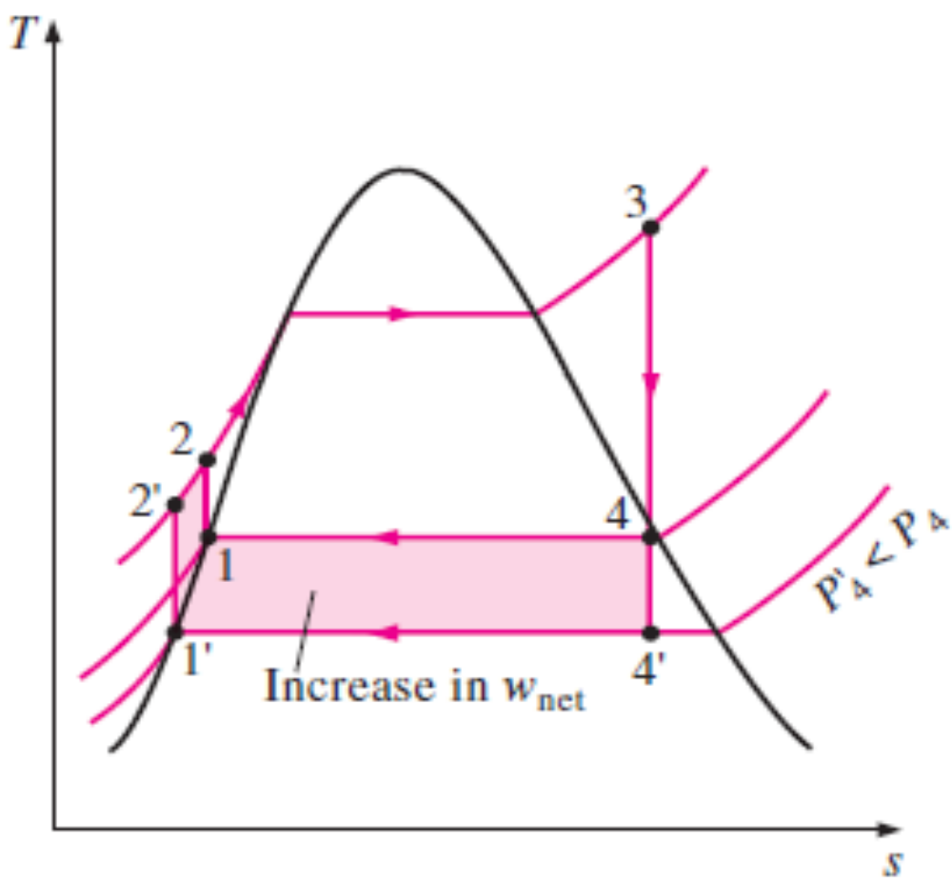
a) Lowering the condenser Pressure (Lowers )

Slide 36
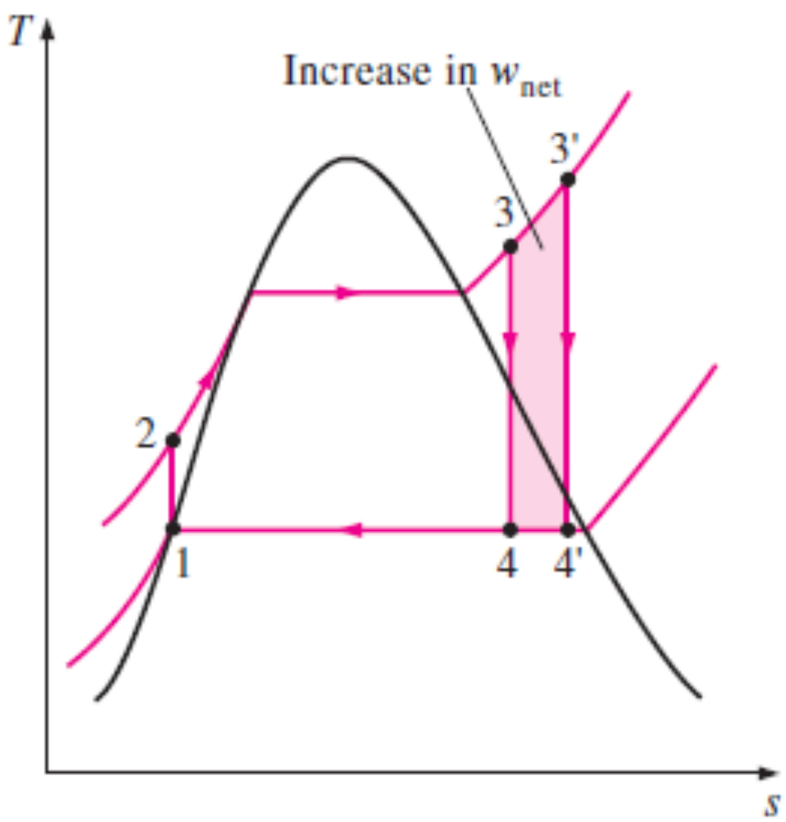
b) Superheating the Steam to High Temperatures (increases )

Slide 37
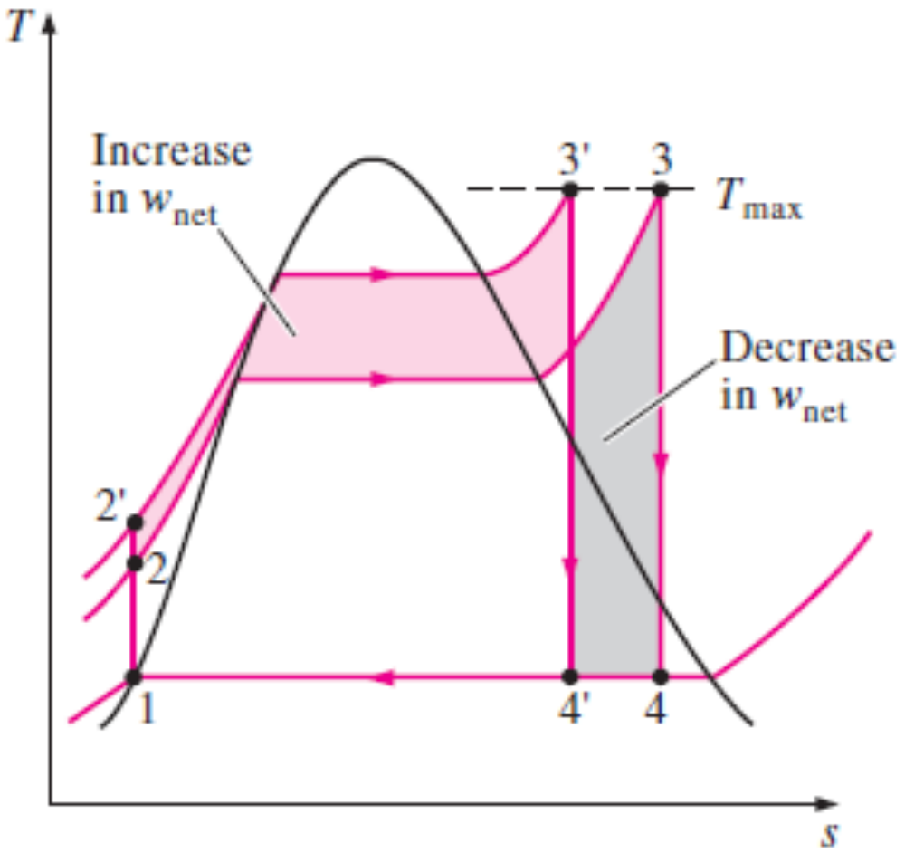
c) Increasing Boiler Pressure (Increases )

Slide 38

KNUST-SESC

